Slide 1


Classroom Management
By Susan Nixon

Slide 2

Effective Classroom Management
Engaging lesson plans
Lesson structure, classroom structure and routines
Positive student, teacher, parent and colleague relationships
Promotion of desired behaviors and decrease of unwanted behaviors
Promoting independent and positive work habits

Slide 3

could easily make a three or four hour presentation
or be taught in a full length course
This PowerPoint will focus on one portion of classroom management
These Factors

Slide 4

Classroom Arrangement

Slide 5
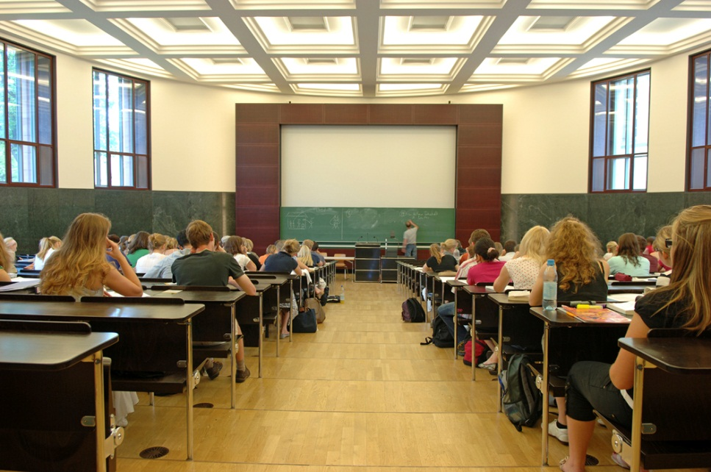
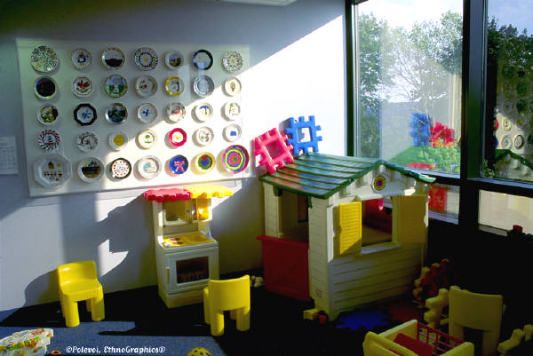
A Successful Learning Environment
Meets the needs of the students
Follows the philosophy of the teacher
Is appropriate to the student age and the content area of the classroom

Slide 6
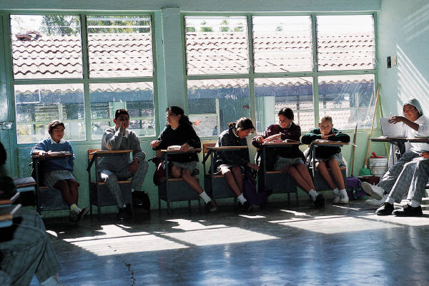

Not Just Furniture Placement
You also set up your room for:
social interaction
learning to follow classroom routines
administrative activities
easy accessibility for supplies
to maximize instruction
teacher philosophy

Slide 7


Types of Instructional Activities
What types of instructional activities will you have?
Age of the students
The subject area
Learning activities
Size of the classroom
Furniture

Slide 8


Materials
Will students need special materials like reference materials or computers?
Location of these materials
Student traffic patterns they create

Slide 9

Special Needs
Does your class have students with special needs?
Set up with your specific students in mind

Slide 10
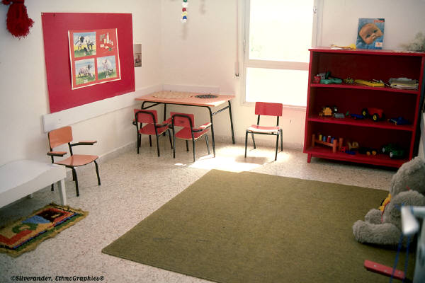
Classroom Movement
How much movement is necessary to meet the academic needs of students?
Do you have students with kinesthetic needs?
Are there many group activities needing movement?
Do you need an open area for students to do circle time or other centers?

Slide 11

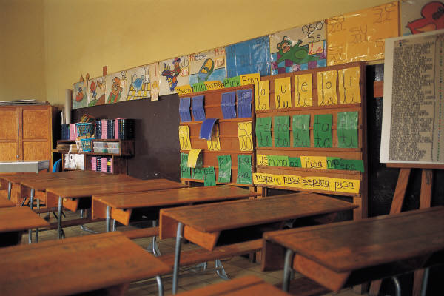
Flexibility
How flexible is the classroom arrangement?
Will it change during the day or the class period or will it remain the same for the entire day?
Are there changes you can make to create more flexibility ?

Slide 12
For More Information
http://www.projectidealonline.org/classMgt_ArrangingClassroom.php
Website to create your own classroom layouts and print them, including seating charts with student names:
http://teacher.scholastic.com/tools/class_setup/
Book on classroom management used for slide two and research:
Making It Till Friday: Your Guide For Effective Classroom Management by James D. Long and Robert L. Williams, Fifth Edition, 2005.
Slides 5-11 content adapted from:

